Slide 1
Chapter 1: Introduction
Notes:
1

Slide 2
Contents
What Operating Systems Do
Computer-System Organization
Computer-System Architecture
Operating-System Structure
Operating-System Operations
Computing Environments
Open-Source Operating Systems

Slide 3
Objectives
To describe the basic organization of computer systems
To provide a grand tour of the major components of operating systems
To give an overview of the many types of computing environments
To explore several open-source operating systems

Slide 4
What is an Operating System?
A program that acts as an intermediary between a user of a computer and the computer hardware
Operating system goals:
Execute user programs and make solving user problems easier
Make the computer system convenient to use
Use the computer hardware in an efficient manner

Slide 5
Computer System Structure
Computer system can be divided into four components:
Hardware – provides basic computing resources
CPU, memory, I/O devices
Operating system
Controls and coordinates use of hardware among various applications and users
Application programs – define the ways in which the system resources are used to solve the computing problems of the users
Word processors, compilers, web browsers, database systems, video games
Users
People, machines, other computers

Slide 6
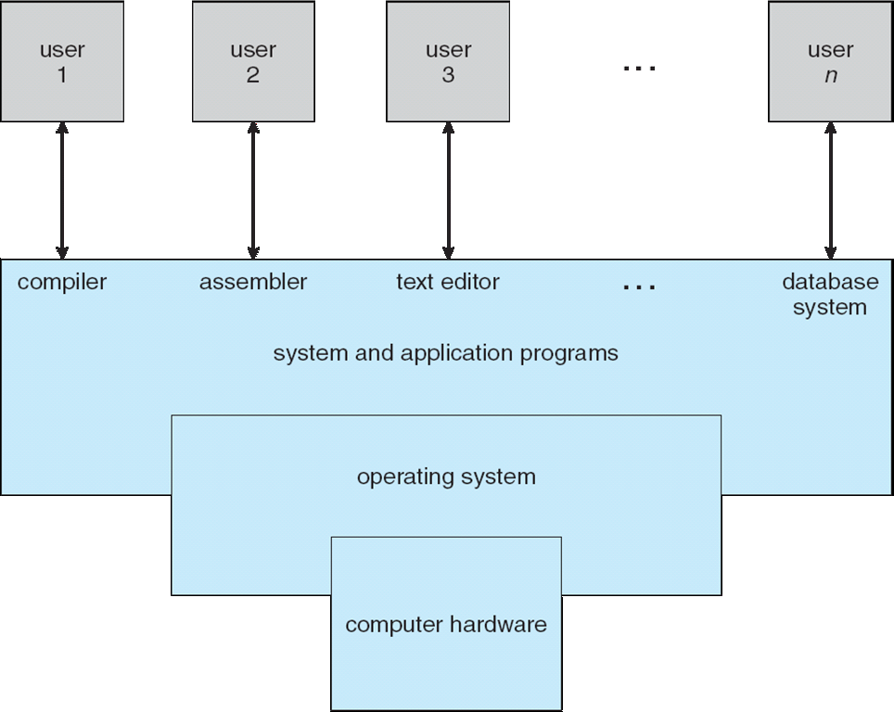
Four Components of a Computer System

Slide 7
What Operating Systems Do
Depends on the point of view
Users want convenience, ease of use
Don’t care about resource utilization
But shared computer such as mainframe or minicomputer must keep all users happy
Users of dedicate systems such as workstations have dedicated resources but frequently use shared resources from servers
Handheld computers are resource poor, optimized for usability and battery life
Some computers have little or no user interface, such as embedded computers in devices and automobiles

Slide 8
Operating System Definition
OS is a resource allocator
Manages all resources
Decides between conflicting requests for efficient and fair resource use
OS is a control program
Controls execution of programs to prevent errors and improper use of the computer

Slide 9
Operating System Definition (Cont.)
No universally accepted definition
“Everything a vendor ships when you order an operating system” is good approximation
But varies wildly
“The one program running at all times on the computer” is the kernel. Everything else is either a system program (ships with the operating system) or an application program.

Slide 10
Computer Startup
bootstrap program is loaded at power-up or reboot
Typically stored in ROM or EPROM, generally known as firmware
Initializes all aspects of system
Loads operating system kernel and starts execution

Slide 11
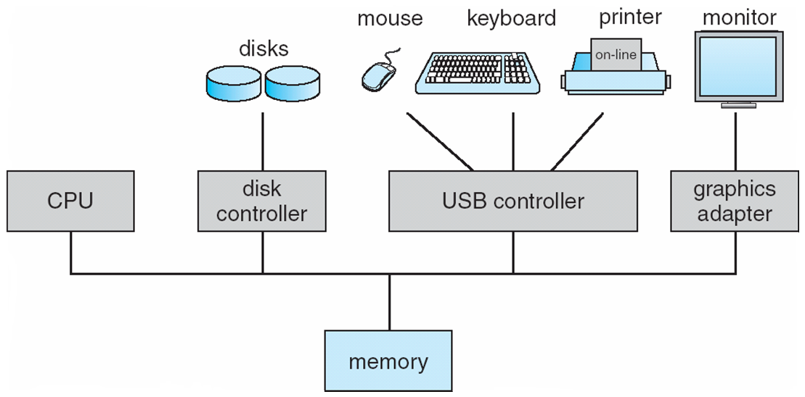
Computer System Organization
Computer-system operation
One or more CPUs, device controllers connect through common bus providing access to shared memory
Concurrent execution of CPUs and devices competing for memory cycles

Slide 12
Computer-System Operation
I/O devices and the CPU can execute concurrently
Each device controller is in charge of a particular device type
Each device controller has a local buffer
CPU moves data from/to main memory to/from local buffers
I/O is from the device to local buffer of controller
Device controller informs CPU that it has finished its operation by causing an interrupt

Slide 13
Common Functions of Interrupts
Interrupt transfers control to the interrupt service routine generally, through the interrupt vector, which contains the addresses of all the service routines
Interrupt architecture must save the address of the interrupted instruction
A trap or exception is a software-generated interrupt caused either by an error or a user request
An operating system is interrupt driven

Slide 14
Interrupt Handling
The operating system preserves the state of the CPU by storing registers and the program counter
Determines which type of interrupt has occurred:
polling
vectored interrupt system
Separate segments of code determine what action should be taken for each type of interrupt

Slide 15
Direct Memory Access Structure
Used for high-speed I/O devices able to transmit information at close to memory speeds
Device controller transfers blocks of data from buffer storage directly to main memory without CPU intervention
Only one interrupt is generated per block, rather than the one interrupt per byte

Slide 16
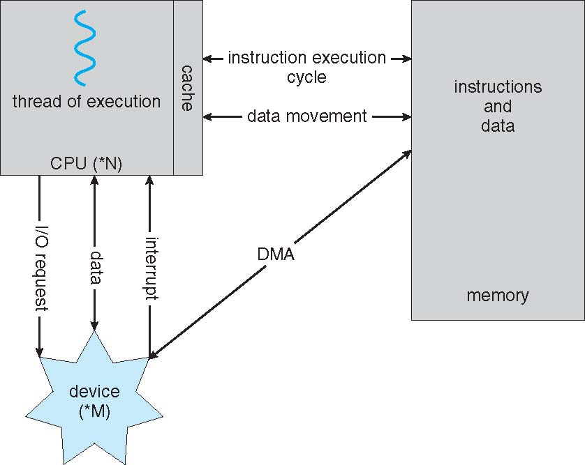
How a Modern Computer Works
A von Neumann architecture

Slide 17
Batch operating system
The users of batch operating system do not interact with the computer directly.
Each user prepares his job on an off-line device like punch cards and submits
it to the computer operator.
To speed up processing, jobs with similar needs are batched together and run
as a group. Thus, the programmers left their programs with the operator.
The operator then sorts programs into batches with similar requirements.
The problems with Batch Systems are following.
• Lack of interaction between the user and job.
• CPU is often idle, because the speeds of the mechanical I/O
devices are slower than CPU.
• Difficult to provide the desired priority.

Slide 18
Operating System Structure
Multiprogramming needed for efficiency
Single user cannot keep CPU and I/O devices busy at all times
Multiprogramming organizes jobs (code and data) so CPU always has one to execute
A subset of total jobs in system is kept in memory
One job selected and run via job scheduling
When it has to wait (for I/O for example), OS switches to another job
Timesharing (multitasking) is logical extension in which CPU switches jobs so frequently that users can interact with each job while it is running, creating interactive computing
Response time should be < 1 second
Processor's time which is shared among multiple users simultaneously is
termed as time-sharing.
Each user has at least one program executing in memory process
If several jobs ready to run at the same time  CPU scheduling
If processes don’t fit in memory, swapping moves them in and out to run
Virtual memory allows execution of processes not completely in memory

Slide 19
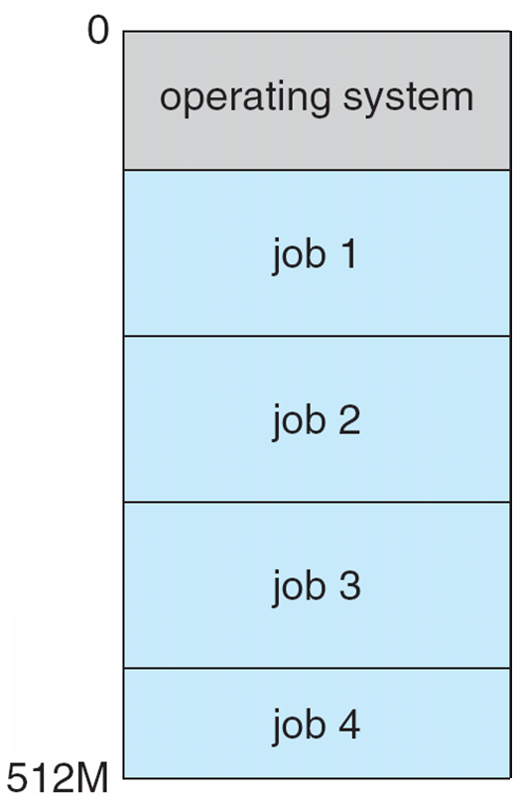
Memory Layout for Multiprogrammed System

Slide 20
The main difference between Multiprogrammed Batch
Systems and Time-Sharing Systems is that in case of
multiprogrammed batch systems, objective is to maximize
processor use, whereas in Time-Sharing Systems objective is to
minimize response time.

Slide 21
Operating-System Operations
Interrupt driven by hardware
Software error or request creates exception or trap
Division by zero, request for operating system service
Other process problems include infinite loop, processes modifying each other or the operating system
Dual-mode operation allows OS to protect itself and other system components
User mode and kernel mode
Mode bit provided by hardware
Provides ability to distinguish when system is running user code or kernel code
Some instructions designated as privileged, only executable in kernel mode
System call changes mode to kernel, return from call resets it to user

Slide 22
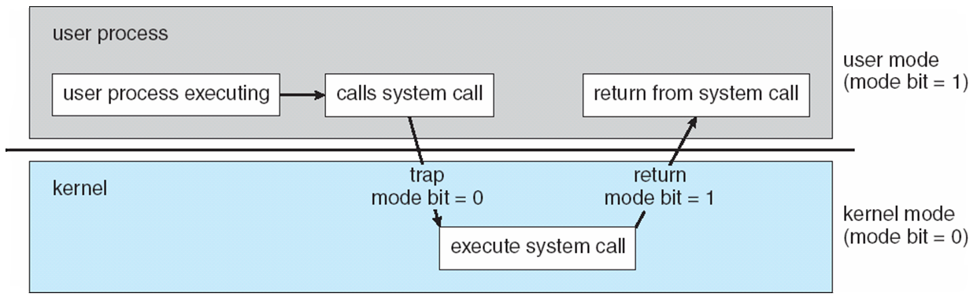
Transition from User to Kernel Mode
Timer to prevent infinite loop / process hogging resources
Set interrupt after specific period
Operating system decrements counter
When counter zero generate an interrupt
Set up before scheduling process to regain control or terminate program that exceeds allotted time

Slide 23
Computing Environments – Cloud Computing
Delivers computing, storage, even apps as a service across a network
Logical extension of virtualization as based on virtualization
Amazon EC2 has thousands of servers, millions of VMs, PBs of storage available across the Internet, pay based on usage
Many types
Public cloud – available via Internet to anyone willing to pay
Private cloud – run by a company for the company’s own use
Hybrid cloud – includes both public and private cloud components
Software as a Service (SaaS) – one or more applications available via the Internet (i.e. word processor)
Platform as a Service (PaaS) – software stack ready for application use via the Internet (i.e a database server)
Infrastructure as a Service (IaaS) – servers or storage available over Internet (i.e. storage available for backup use)

Slide 24
Computing Environments – Cloud Computing
Cloud compute environments composed of traditional OSes, plus VMMs, plus cloud management tools
Internet connectivity requires security like firewalls
Load balancers spread traffic across multiple applications

Slide 25
Computing Environments – Real-Time Embedded Systems
Real-time embedded systems most prevalent form of computers
Vary considerable, special purpose, limited purpose OS, real-time OS
Use expanding
Many other special computing environments as well
Some have OSes, some perform tasks without an OS
Real-time OS has well-defined fixed time constraints
Processing must be done within constraint
Correct operation only if constraints met
For example Scientific experiments, medical imaging systems,
industrial control systems, weapon systems, robots, and home-appliance controllers, Air traffic
control system etc.

Slide 26
Computing Environments – Real-Time Embedded Systems
There are two types of real-time operating systems.
Hard real-time systems
Hard real-time systems guarantee that critical tasks complete on time. In hard
real-time systems secondary storage is limited or missing with data stored in ROM.
In these systems virtual memory is almost never found.
Soft real-time systems
Soft real time systems are less restrictive. Critical real-time task gets priority over
other tasks and retains the priority until it completes. Soft real-time systems have
limited utility than hard real-time systems. For example,
Multimedia, virtual reality, Advanced Scientific Projects like
undersea exploration and planetary rovers etc.

Slide 27
Distributed operating System
Distributed systems use multiple central processors
to serve multiple real time application and
multiple users. Data processing jobs are distributed
among the processors accordingly to which
one can perform each job most efficiently.

Slide 28
Distributed operating System
The advantages of distributed systems are following.
With resource sharing facility user at one site may be able to
use the resources available at another.
Speedup the exchange of data with one another via
electronic mail.
If one site fails in a distributed system, the remaining sites can
potentially continue operating.
Better service to the customers.
Reduction of the load on the host computer.
Reduction of delays in data processing.

Slide 29
Network operating System
Network Operating System runs on a server and and provides server the capability to
manage data, users, groups, security, applications, and other networking functions.
The primary purpose of the network operating system is to allow shared file
and printer access among multiple
computers in a network, typically a local area network (LAN), a private network or to other
networks. Examples of network operating systems are Microsoft Windows Server 2003,
Microsoft Windows Server 2008, UNIX, Linux, Mac OS X, Novell NetWare, and BSD.

Slide 30
Open-Source Operating Systems
Operating systems made available in source-code format rather than just binary closed-source
Counter to the copy protection and Digital Rights Management (DRM) movement
Started by Free Software Foundation (FSF), which has “copyleft” GNU Public License (GPL)
Examples include GNU/Linux and BSD UNIX (including core of Mac OS X), and many more
Can use VMM like VMware Player (Free on Windows), Virtualbox (open source and free on many platforms - http://www.virtualbox.com)
Use to run guest operating systems for exploration

Slide 31
End of Chapter 1
Notes:
31

